Slide 1
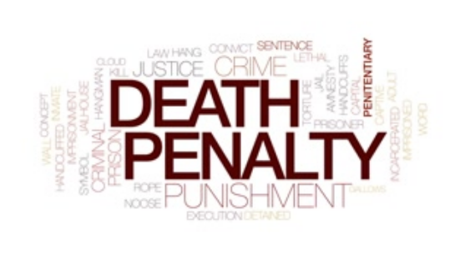


Slide 2
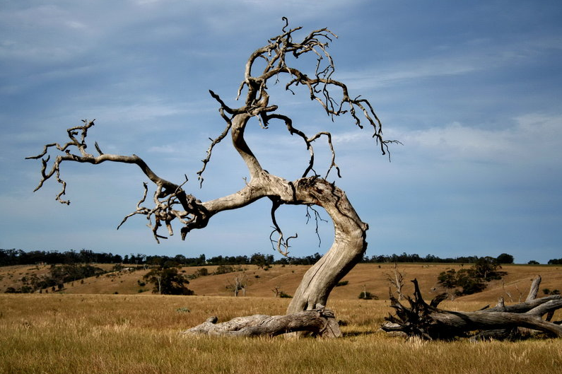
The Death
Fig Tree
of a
Matthew 21:18-22

Slide 3
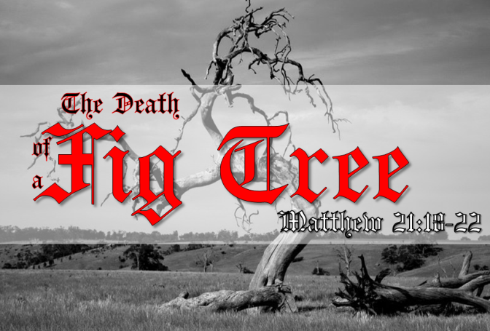
“
Matthew 21:18-22
N
Now in the morning, when He was returning to the city, He became hungry. (19) Seeing a lone fig tree by the road, He came to it and found nothing on it except leaves only; and He *said to it, "No longer shall there ever be any fruit from you." And at once the fig tree withered. (20) Seeing this, the disciples were amazed and asked, "How did the fig tree wither all at once?" (21) And Jesus answered and said to them, "Truly I say to you, if you have faith and do not doubt, you will not only do what was done to the fig tree, but even if you say to this mountain, 'Be taken up and cast into the sea,' it will happen. (22) "And all things you ask in prayer, believing, you will receive."
Romans 11:17-22
Matthew 3:7-10
Isaiah 5:1-7
Luke 13:6-9

Slide 4
“
John 15:1-8
I
I am the true vine, and My Father is the vinedresser. Every branch in Me that does not bear fruit He takes away; and every branch that bears fruit He prunes, that it may bear more fruit. You are already clean because of the word which I have spoken to you. Abide in Me, and I in you. As the branch cannot bear fruit of itself, unless it abides in the vine, neither can you, unless you abide in Me. "I am the vine, you are the branches. He who abides in Me, and I in him, bears much fruit; for without Me you can do nothing. If anyone does not abide in Me, he is cast out as a branch and is withered; and they gather them and throw them into the fire, and they are burned. If you abide in Me, and My words abide in you, you will ask what you desire, and it shall be done for you. By this My Father is glorified, that you bear much fruit; so you will be My disciples.

Slide 5
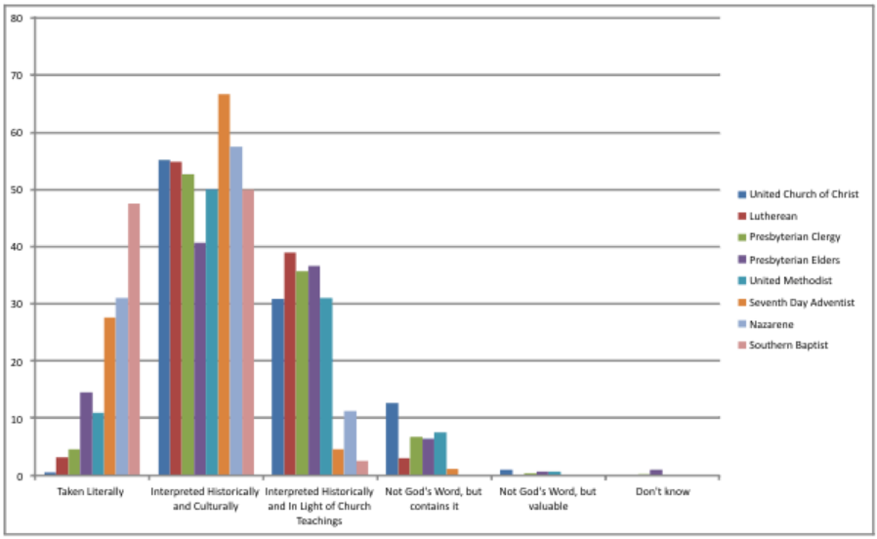

Slide 6
Titus 1:16
“They profess to know God, but by their deeds they deny Him, being detestable and disobedient and worthless for any good deed.”

Slide 7
“
Galatians 5:22-25
B
But the fruit of the Spirit is love, joy, peace, patience, kindness, goodness, faithfulness, (23) gentleness, self-control; against such things there is no law. (24) Now those who belong to Christ Jesus have crucified the flesh with its passions and desires. (25) If we live by the Spirit, let us also walk by the Spirit.”
Does This Describe You?

Slide 8
The Death
Fig Tree
of a
Matthew 21:18-22

